Slide 1
Basic Gate Implementation Using Verilog in Xilinx
Lab 1
By:
Er. Shiva Raj Luitel

Slide 2
Objective
To get familiar with different approach of Verilog programming and implementing it using Xilinx ISE design suite.

Slide 3
Theory
Verilog is a Hardware Description Language (HDL). It is a language used for describing a digital system such as a network switch, a microprocessor, a memory, or a flip-flop.
We can describe any digital hardware by using HDL at any level. Designs described in HDL are independent of technology, very easy for designing and debugging, and are normally more useful than schematics, particularly for large circuits.

Slide 4
Different Approach on Verilog
Dataflow approach
Behavioral Approach
Structural Approach

Slide 5
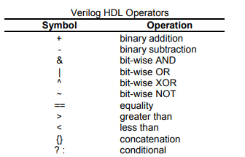
Dataflow Approach/ Model
Dataflow modeling provides the means of describing combinational circuits by their function rather than by their gate structure. Dataflow modeling uses a number of operators that act on operands to produce the desired results.
Example: Y= A|B, Z=A&B, X=A^B

Slide 6
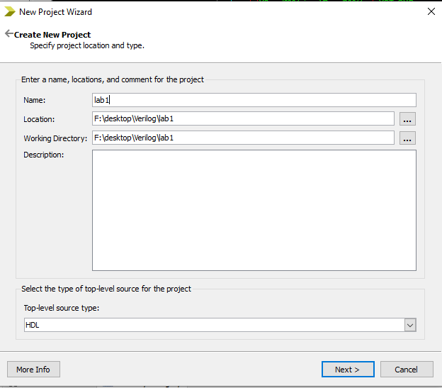
Start with Xilinx
Open Xilinx ISE design Suite
Then Click File<<New Project.
Create New Wizard appears. Fill it with appropriate name, location and working directory. Click Next

Slide 7
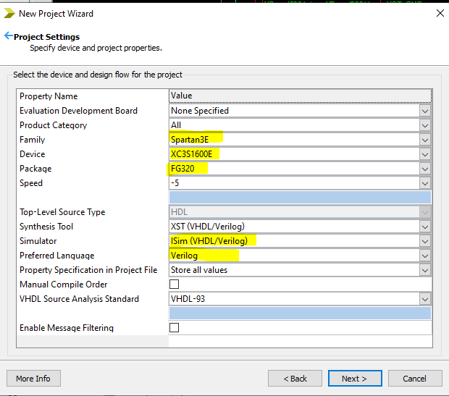
Select as mentioned in figure

Slide 8
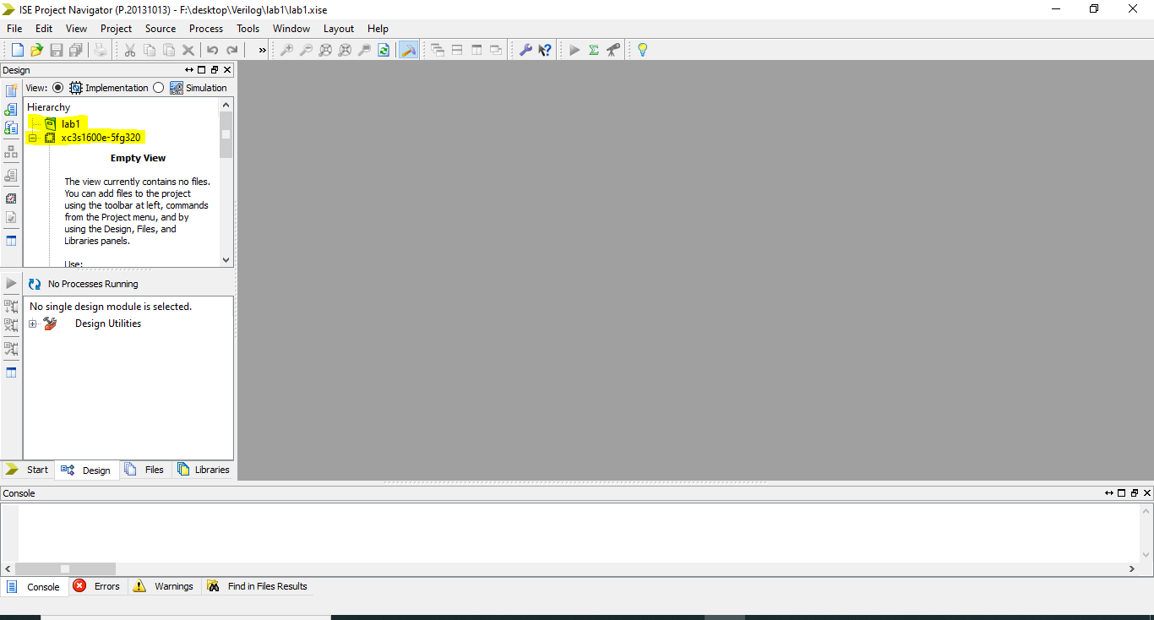
Project summary shows the summary of project and review if any mistake go to back else click finish.

Slide 9
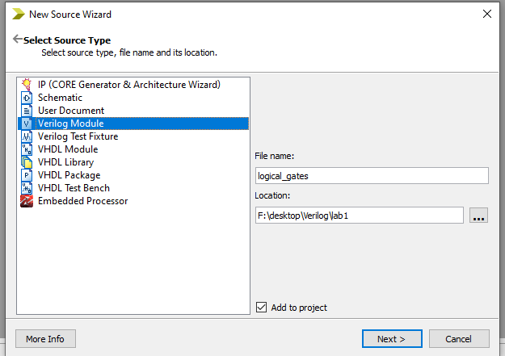
Now, right click on IC mentioned just below project name. Then click New source

Slide 10
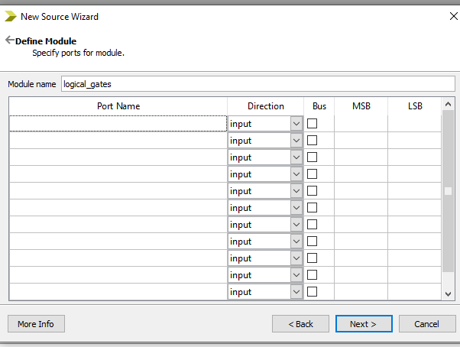
Click next. Wizard box as shown below appears. So, add port as required and select appropriate direction. Ticking bus allows multiple bit operand and MSB and LSB gives information of no of bits. Eg. If MSB=2 and LSB=0, its 3-bit operand.

Slide 11
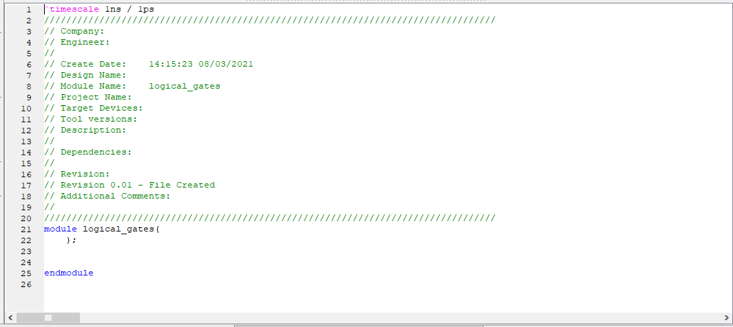
Click Next. File summary will appear. Check if any mistake and click finish. The editor as below appears and write the code for Verilog.

Slide 12
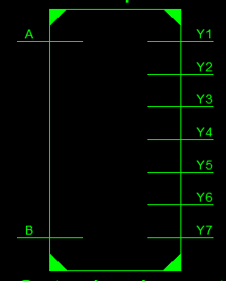
Dataflow model Implementation in Verilog
Module BasicGatesImplementation(
input A,
input B,
output Y1,
output Y2,
output Y3,
output Y4,
output Y5,
output Y6,
output Y7 );
assign Y1= A|B;
assign Y2= A&B;
assign Y3= ~A;
assign Y4= ~(A|B);
assign Y5= ~(A &B);
assign Y6= A^B;
assign Y7= ~(A^B);
endmodule

Slide 13
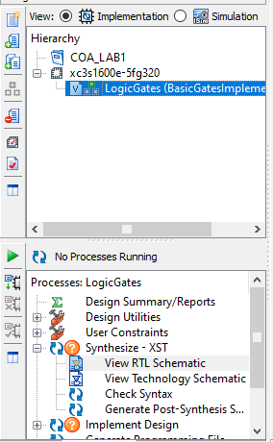
After completing writing code, click play button as shown in figure below
If everything goes fine, then click view RTL Schematic<<Start with schematic top level<<OK. Then RTL will appear. Each block can be expanded with double click until gate level circuit is appeared.
Remind here: Until this we are in Implementation mode.
So, to check how our circuit behaves, we should do simulation.
Now shift to simulation mode.
Now Right Click the file created under IC name<< new source<<Verilog test fixture (provide name and location. Note that the name should not be that of file). <<Next<<finish

Slide 14
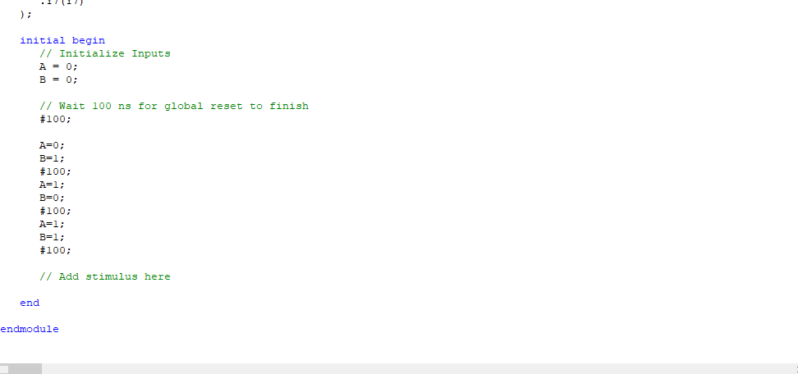
Now the editor appears. Move to section initial begin and give test value as shown in figure below. #100 means wait for 100ns during simulation.

Slide 15
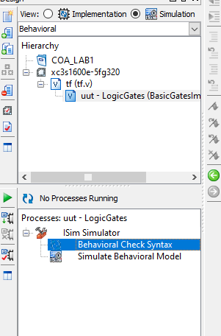
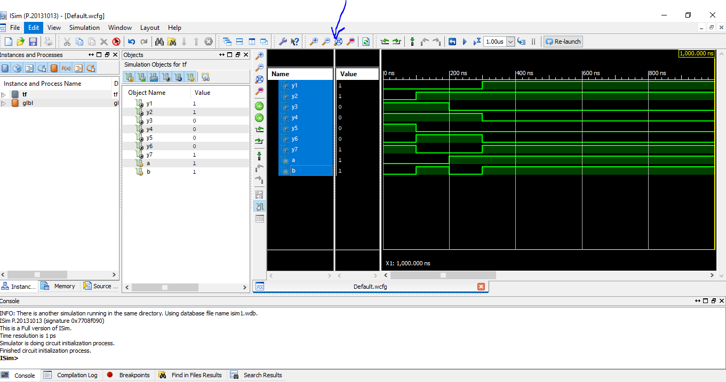
Click the file name. Then in process section you can see ISIM. Expand it. Double click on behavioral check syntax. It tests whether the test value given are correct or not. If it tick green, then double click on simulate behavioral model. Now the simulation in ISIM appears as shown. Click Fit to screen in zoom section, then check the output on provided value.

Slide 16
Behavioral model
Behavioral modeling represents digital circuits at a functional and algorithmic level. It is used mostly to describe sequential circuits, but can be used to describe combinational circuits.
Here the behavioral modeling concept will be presented for combinational circuits. Behavioral description use the keyword always followed by a list of procedural assignment statements. The target output of procedural assignment statement must be of the reg data type.

Slide 17
Behavioral Implementation (using if- statement)
always @(A or B)
begin
if (A== 0 & B==0)
begin
Y1=0;
Y2=0;
Y3=1;
Y4=1;
Y5=1;
Y6=0;
Y7=1;
end
else if (A==0 & B==1)
begin
Y1=1;
Y2=0;
Y3=0;
Y4=0;
Y5=1;
Y6=1;
Y7=0;
end
else if (A==1 & B==0)
begin
Y1=1;
Y2=0;
Y3=0;
Y4=0;
Y5=1;
Y6=1;
Y7=0;
end
else
begin
Y1=1;
Y2=1;
Y3=0;
Y4=0;
Y5=0;
Y6=0;
Y7=1;
end
end
endmodule
Module BasicGatesImplementation(
input A,
input B,
output Y1,
output Y2,
output Y3,
output Y4,
output Y5,
output Y6,
output Y7 );

Slide 18
Structural Model
Structural Verilog descriptions assemble several blocks of code and allow the introduction of hierarchy in a design. The basic concepts of hardware structure are the module, the port and the signal.
The component is the building or basic block. A port is a component I/O connector. A signal corresponds to a wire between components.

Slide 19
Structural Model
module LogicGates(a,b,y1,y2,y3,y4,y5,y6,y7); input a,b; output y1,y2,y3,y4,y5,y6,y7; and(y1,a,b); or(y2,a,b); not(y3,a); nand(y4,a,b); nor(y5,a,b); xor(y6,a,b); xnor(y7,a,b); endmodule

Slide 20
Observation:
RTL and timing diagram

Slide 21
Discussion and conclusion

